Slide 1
Introduction to Python
Matthew Hielsberg
hielsber@tamu.edu
TAMIDS Data Science Bootcamp
08/09/2022

Slide 2
License and Disclaimer
MIT License
Copyright (c) 2022 Matthew Hielsberg
Permission is hereby granted, free of charge, to any person obtaining a copy of this software and
associated documentation files (the "Software"), to deal in the Software without restriction, including
without limitation the rights to use, copy, modify, merge, publish, distribute, sublicense, and/or sell copies of
the Software, and to permit persons to whom the Software is furnished to do so, subject to the following
conditions:
The above copyright notice and this permission notice shall be included in all copies or substantial portions
of the Software.
THE SOFTWARE IS PROVIDED "AS IS", WITHOUT WARRANTY OF ANY KIND, EXPRESS OR
IMPLIED, INCLUDING BUT NOT LIMITED TO THE WARRANTIES OF MERCHANTABILITY, FITNESS
FOR A PARTICULAR PURPOSE AND NONINFRINGEMENT. IN NO EVENT SHALL THE AUTHORS OR
COPYRIGHT HOLDERS BE LIABLE FOR ANY CLAIM, DAMAGES OR OTHER LIABILITY, WHETHER IN
AN ACTION OF CONTRACT, TORT OR OTHERWISE, ARISING FROM, OUT OF OR IN CONNECTION
WITH THE SOFTWARE OR THE USE OR OTHER DEALINGS IN THE SOFTWARE.

Slide 3
Workshop Materials
Github:
hielsber-tamu/tamids-ds-bootcamp-python-0822
Contains all materials you will see today
TAMIDS Python Primer:
https://training.tamids.tamu.edu/python-primer/
Covers everything in this workshop and more
Consists of 45 videos + Jupyter Notebooks
Videos range from 1 min to 17 min in length
Notes:
notebooks are meant to be self contained
Try to make no assumption about background, prev prog lang exp

Slide 4
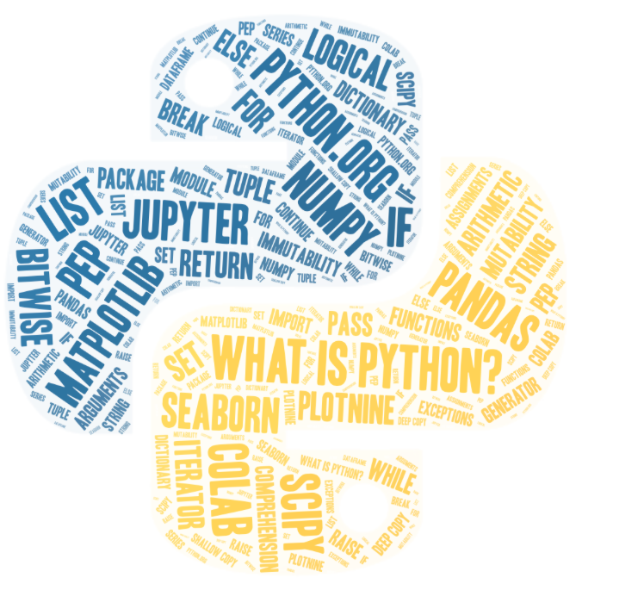
Topics
What is Python?
Python Resources
Enhancement Proposals
Installation Information
Interpreter and IDE’s
Jupyter Project
Anaconda
Google Colab
Python Language
Notes:
Image from wordart.com
notebooks are meant to be self contained
Try to make no assumption about background, prev prog lang exp

Slide 5
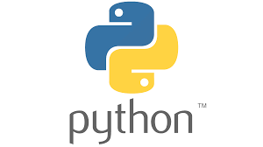
What is Python?
Powerful programming language
High-level
Simple, easy-to-read syntax
Object-oriented
Interpreted – No compilation required
Freely available
Extensible, even using other programming languages
Name comes from BBC show: Monty Python's Flying Circus
Notes:
Very popular, currently in the top 5 used programming languages, usually # 1 or 2
High level : meaning higher level of abstraction from machine code e.g. variables, arrays, objects, loops, functions, as opposed to memory addresses, bytes, etc.
this allows for complex operations to be performed with simple statements
Simple : Easy to understand syntax, code is readable not cryptic
e.g. indentation is used to group statements rather than brackets as in C++ and others
NO declarations required, variables or names can be used immediately and Python will dynamically type them
OO : language uses objects, which can contain both data and code. Data can be attributes, fields, properties. Code or methods/functions that act on that data.
Python is multi-paradigm in that it not only supports OO but also aspects from procedural or functional programming
Interpreted : no compilation, makes the edit-test-debug cycle very fast. This feature is probably the most loved.

Slide 6
Helpful Links
Python.org: The official site for everything Python.
Getting Started: Lots of information for beginners.
Python 3.10 Tutorial: Covers much of the language and capabilities.
Python 3.10 Documentation: Official documentation for Python 3.10.
Python Language Reference: Describes the syntax and core semantics.
Full Grammar Specification: For those interested in knowing how your code will be parsed, this link provides the full grammar used by the language.
Python Standard Library: Describes the standard functionality of Python.
Python Package Index (PyPI): Repository of community-built software for the Python programming language.
Many others… (e.g. RealPython.com and StackOverflow)
Notes:
Useful links to get started
Notebooks included in workshop have many many links to more resources and relevant documentation (for each topic)

Slide 7
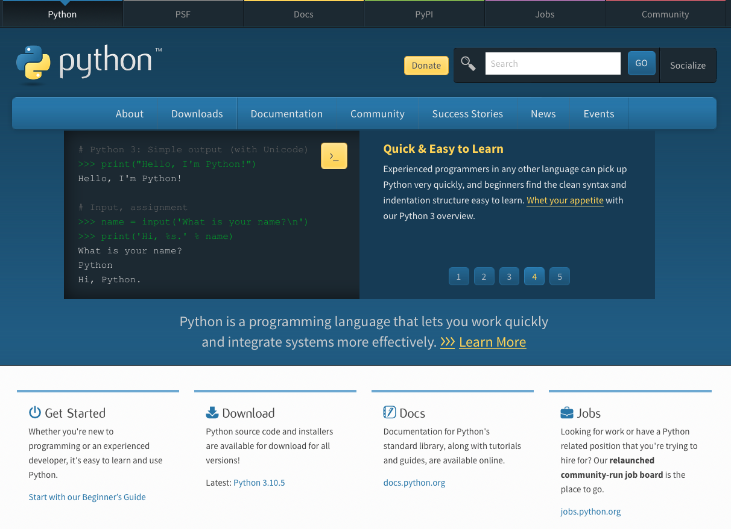
Python.org

Slide 8
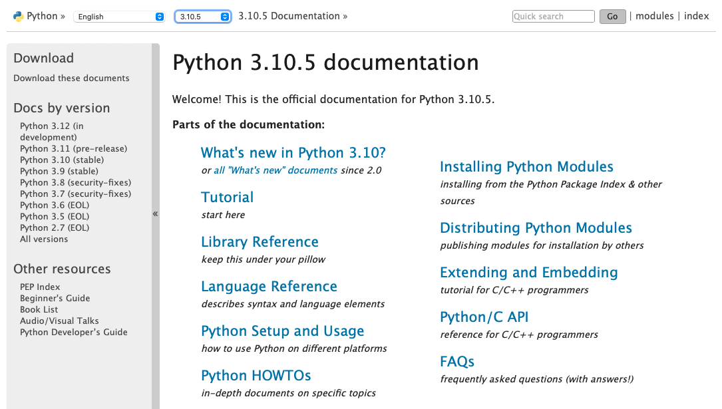
Documentation
https://docs.python.org/3/
Notes:
Version in red box - select your version for most accurate documentation
links to lots of other useful info

Slide 9
Python 2
January 1, 2020 - Python 2 stopped receiving support.
Python 2 and Python 3 are not compatible – e.g., print.
We will only use Python 3.

Slide 10
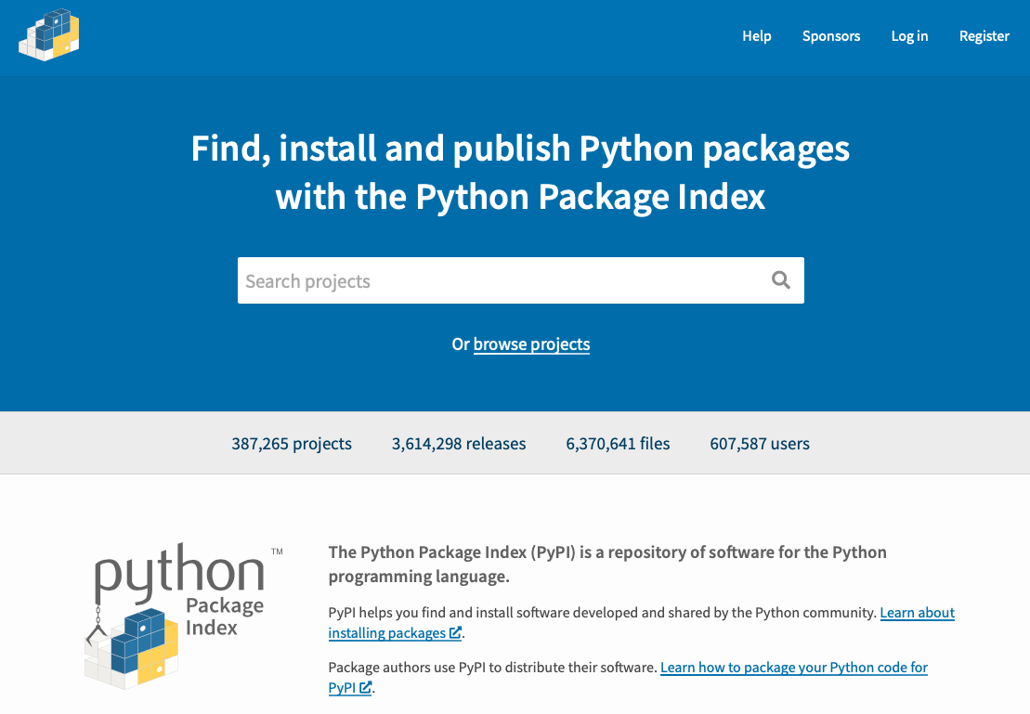
Python Package Index
https://pypi.org
Notes:
Community driven
Tons of stuff
Searching here will often turn up many duplicates (or very similar) – best to ask around or check out domain specific resources/groups
Perhaps demo a search for wavelets to show the duplication and need to look to their community for recommendations

Slide 11
Python Enhancement Proposals
A PEP is a design document that provides information to the Python community or describes a new feature for Python or its processes or environment.
PEP 0 – The index of PEPs
PEP 1 (PEP Purpose and Guidelines) – This describes PEPs and the process they must go through to officially become part of or modify the language.
PEP 8 (Style Guide) - Promotes a readable, eye-pleasing coding style to which most projects adhere.
Strongly recommend reading PEP8!
Use 4-space indentation and no tabs.
Wrap lines so they are 79 or fewer characters.
Use blank lines to separate functions and classes, and larger blocks of code inside functions.
Name your classes and functions consistently.
…
PEP 20 (The Zen of Python) – Long time Pythoneer Tim Peters succinctly channels the BDFL’s guiding principles for Python’s design into 20 aphorisms, only 19 of which have been written down.
>>> import this
Notes:
Guido van Rossum created python in the late 80’s and first released in 1991, Python 2 in 2000, and Python 3 in 2008
Steering Council (5 members – core developers) was not elected until 2019
Guido was first (~1995) to be given title of interim Benevolent dictator for life (since then other open-source project leaders have received the title)
Following PEP8
- make code easier to read and faster to understand,
reduce the number of common mistakes
It is recommended that all Python developers read this document.
PEP20
Explicit is better than implicit.,
Simple is better than complex.
Readability counts.
Now is better than never.
…
(Wikipedia) Benevolent dictator for life (BDFL) title given to a small number of open-source software development leaders, typically project founders who retain the final say in disputes or arguments within the community. The phrase originated in 1995 with reference to Guido van Rossum, creator of the Python programming language.

Slide 12
Installation
Python
https://www.python.org – Click on Downloads
https://wiki.python.org/moin/BeginnersGuide/Download
Jupyter Notebook & Anaconda
https://jupyter.org – Click on Install in the top Menu
https://www.anaconda.com – Click the Download button
Google Colab
No Installation Required – We will use this today!
Notes:
The github repo includes an old pdf with some instructions.

Slide 13
No installation required today!
Notes:
Before getting into Colab – intro other options briefly

Slide 14
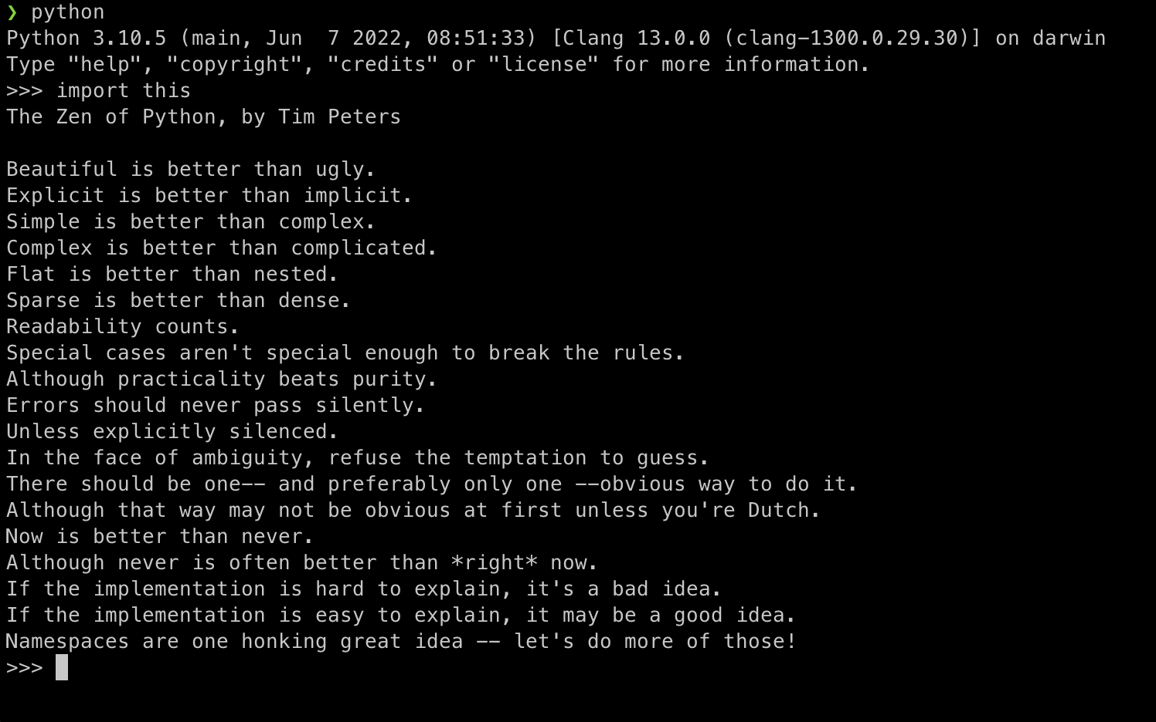

Command Line
To Invoke Python:
python (or python3)
python myScript.py
See documentation for more options
pdb: Python Debugger
https://docs.python.org/3/library/pdb.html
python -m pdb myScript.py
.
>>> import pdb
>>> import mymodule
>>> pdb.run('mymodule.test()')
https://docs.python.org/3/using/cmdline.html
Open in Colab
Notes:
Guido van Rossum created python in the late 80’s and first released in 1991, Python 2 in 2000, and Python 3 in 2008
Steering Council (5 members – core developers) was not elected until 2019
Guido was first (~1995) to be given title of interim Benevolent dictator for life (since then other open-source project leaders have received the title)
(Wikipedia) Benevolent dictator for life (BDFL) title given to a small number of open-source software development leaders, typically project founders who retain the final say in disputes or arguments within the community. The phrase originated in 1995 with reference to Guido van Rossum, creator of the Python programming language.

Slide 15
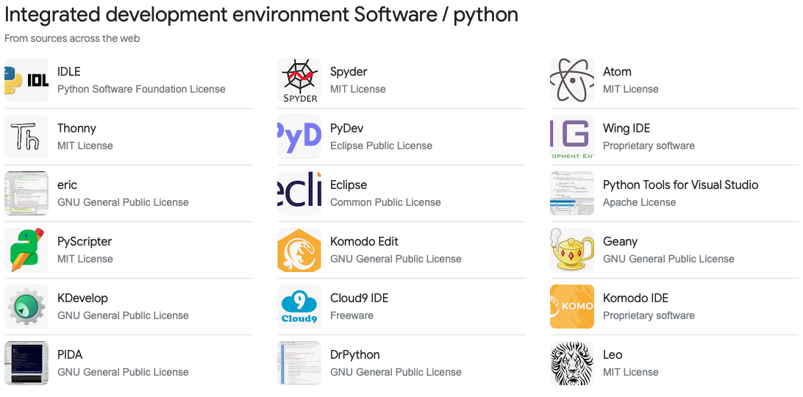
IDE’s – Many Options
Google Search: Python IDE

Slide 16
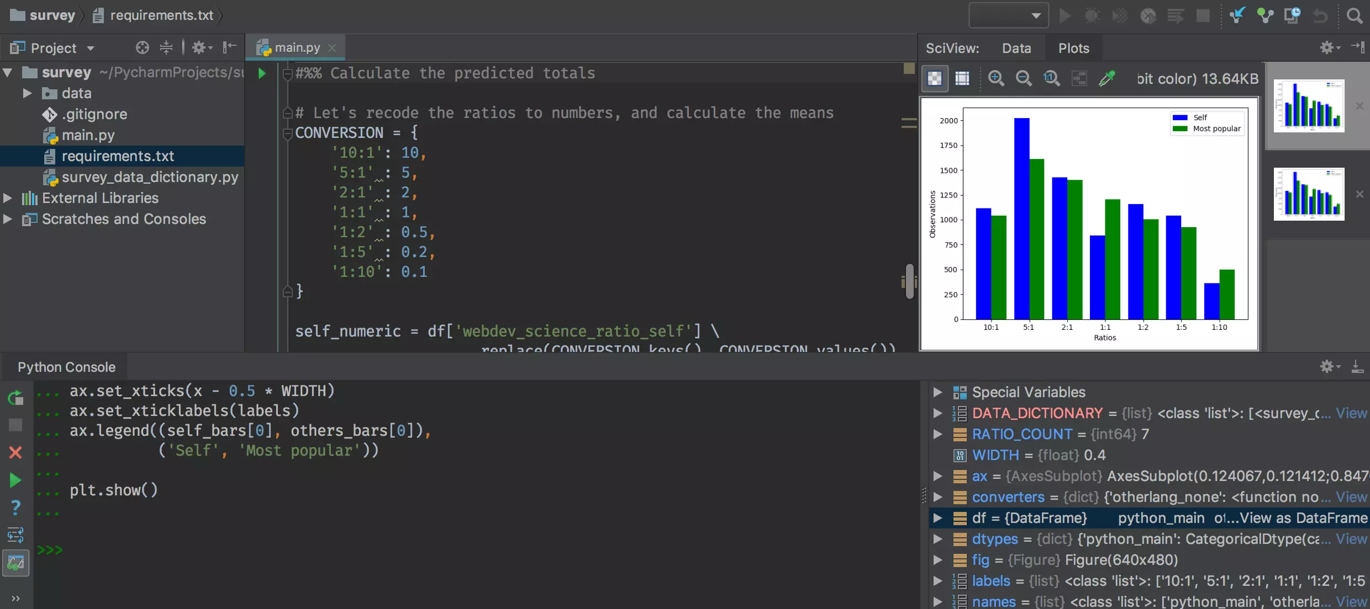

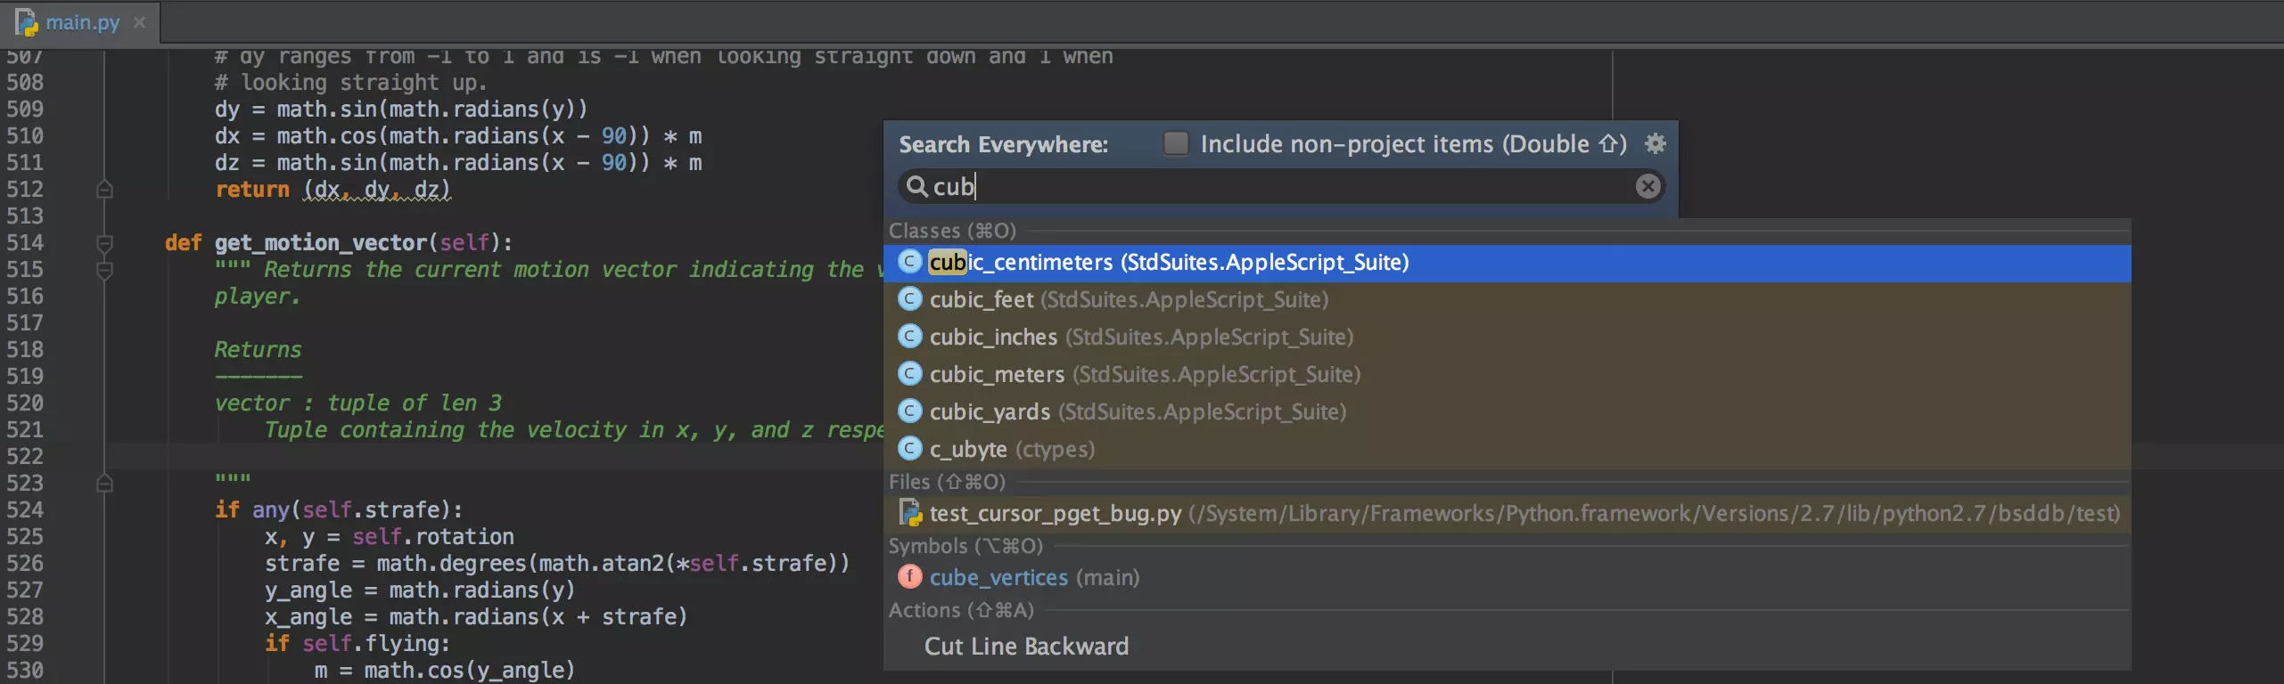
IDE’s – PyCharm
https://www.jetbrains.com/pycharm/

Slide 17
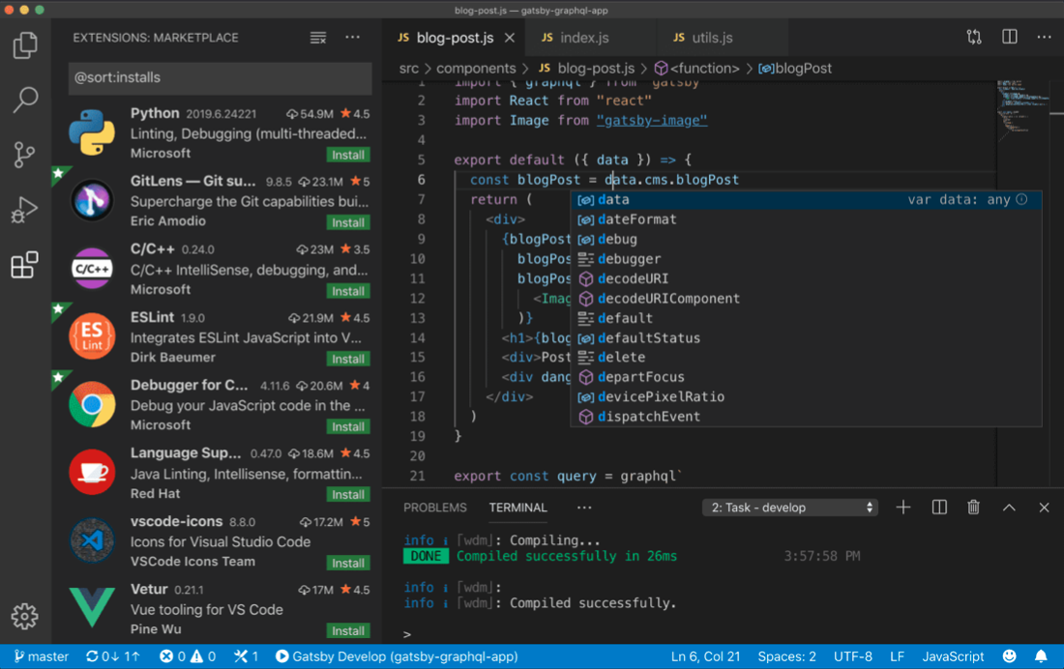
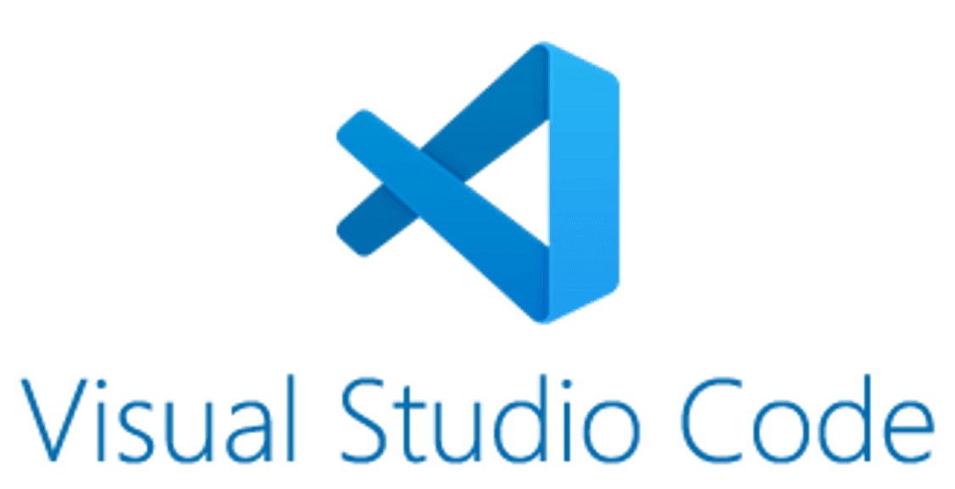
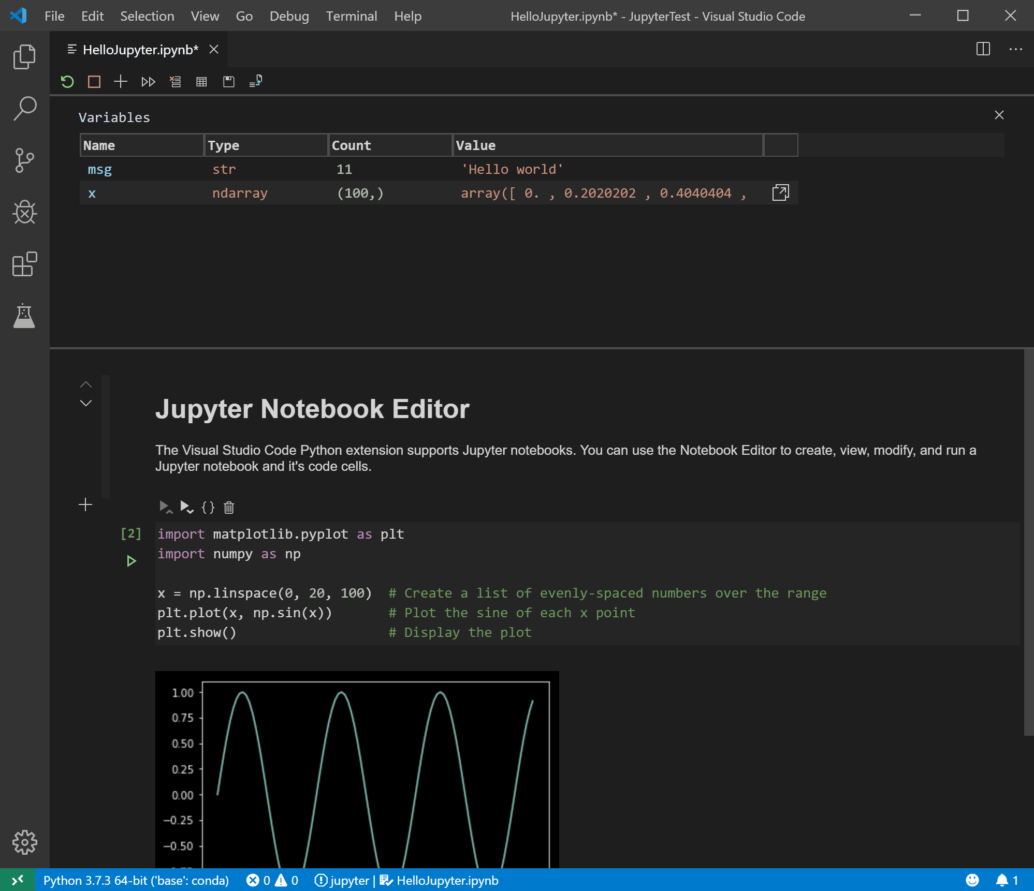
IDE’s – Visual Studio Code
https://code.visualstudio.com

Slide 18
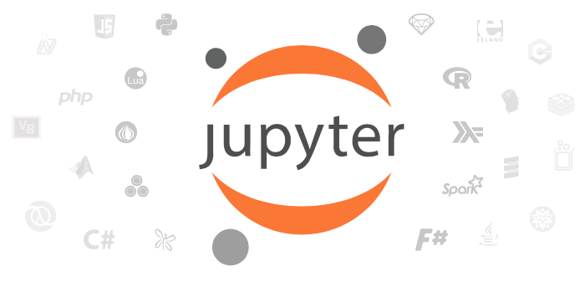
Jupyter Project
Open-source project that came out of the IPython Project (https://ipython.org).
Created to support and promote interactive data science and scientific computing.
Originally built to support the Julia, Python and R, but it now supports many additional languages (Python is installed by default, and other kernels can be installed as needed).
The Jupyter project includes:
Jupyter Notebook
Jupyter Hub
JupyterLab
Voilà
To try out these tools without
installing: https://jupyter.org/try
https://jupyter.org
Notes:
Jupyter Notebook is the original web application for creating and sharing computational documents. It offers a simple, streamlined, document-centric experience.
JupyterLab is the latest web-based interactive development environment for notebooks, code, and data. Its flexible interface allows users to configure and arrange workflows in data science, scientific computing, computational journalism, and machine learning. A modular design invites extensions to expand and enrich functionality.
Jupyter Hub: A multi-user version of the notebook designed for companies, classrooms and research labs
Voilà helps communicate insights by transforming notebooks into secure, stand-alone web applications that you can customize and share

Slide 19
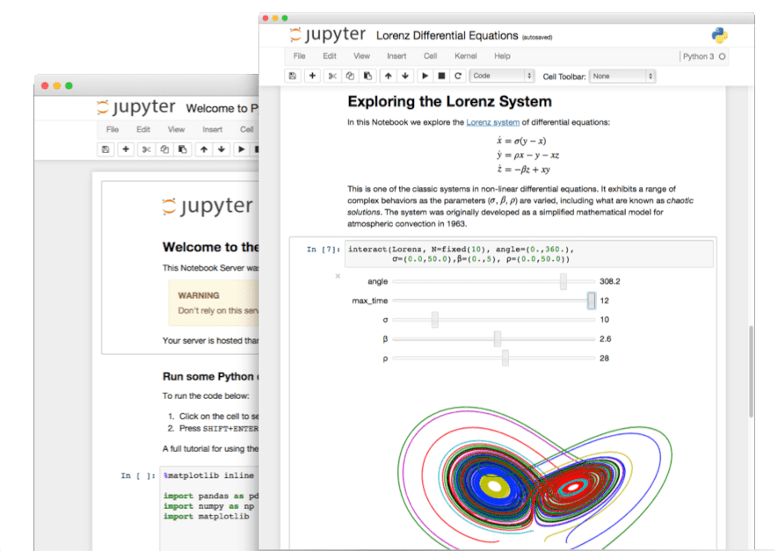
Jupyter Notebook
Web application that allows users to share documents that contain not only text and images, but also live code, equations and visualizations.
Live code means that you can edit and play with any examples directly in your web browser.
Gaining popularity and are being used in a wide variety of research areas:
Data processing, numerical simulation, statistical modeling, machine learning, visualization…
“A gallery of interesting Jupyter Notebooks” https://github.com/jupyter/jupyter/wiki
*https://jupyter.org

Slide 20
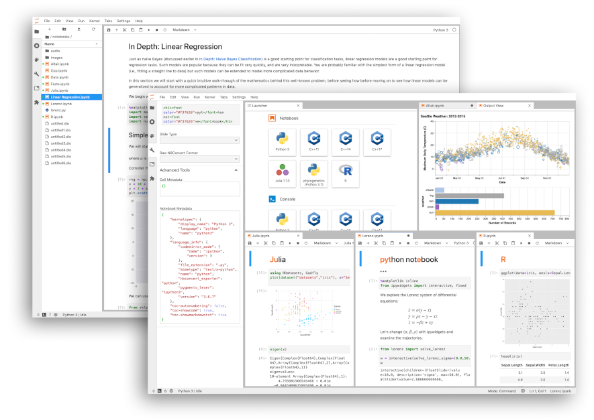
Jupyter Lab
Builds on and extends Jupyter Notebook.
Gives flexible tabular interface allowing for multiple notebooks to be viewed/edited.
Provides:
File Browser
Extension Manager
Debugging Tools (as of v3.0).
Console and Terminal Access
Editors for Markdown and Scripts
*https://jupyter.org
Notes:
Perhaps demo Jupyter lab quickly

Slide 21

Jupyter Hub
Multi-user version of Jupyter Notebook.
Built for companies, classrooms and research labs.
Allows an organization to deploy notebooks to large numbers of users, using Docker and Kubernetes.
Supports pluggable authentication.
Google Colab is similar, but not the same product.
Notes:
Jupyter Notebook is the original web application for creating and sharing computational documents. It offers a simple, streamlined, document-centric experience.
JupyterLab is the latest web-based interactive development environment for notebooks, code, and data. Its flexible interface allows users to configure and arrange workflows in data science, scientific computing, computational journalism, and machine learning. A modular design invites extensions to expand and enrich functionality.
Jupyter Hub: A multi-user version of the notebook designed for companies, classrooms and research labs
Voilà helps communicate insights by transforming notebooks into secure, stand-alone web applications that you can customize and share

Slide 22
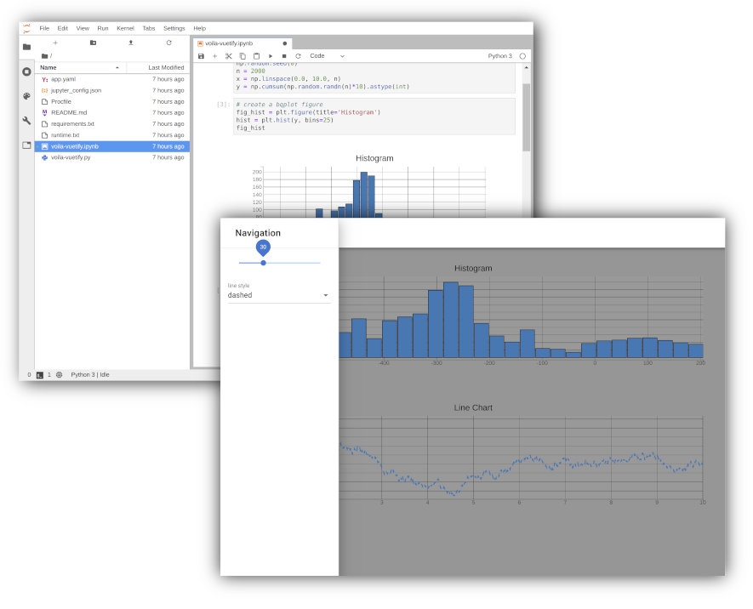
Voilà
Converts notebooks into secure, stand-alone web applications that you can customize and share.

Slide 23
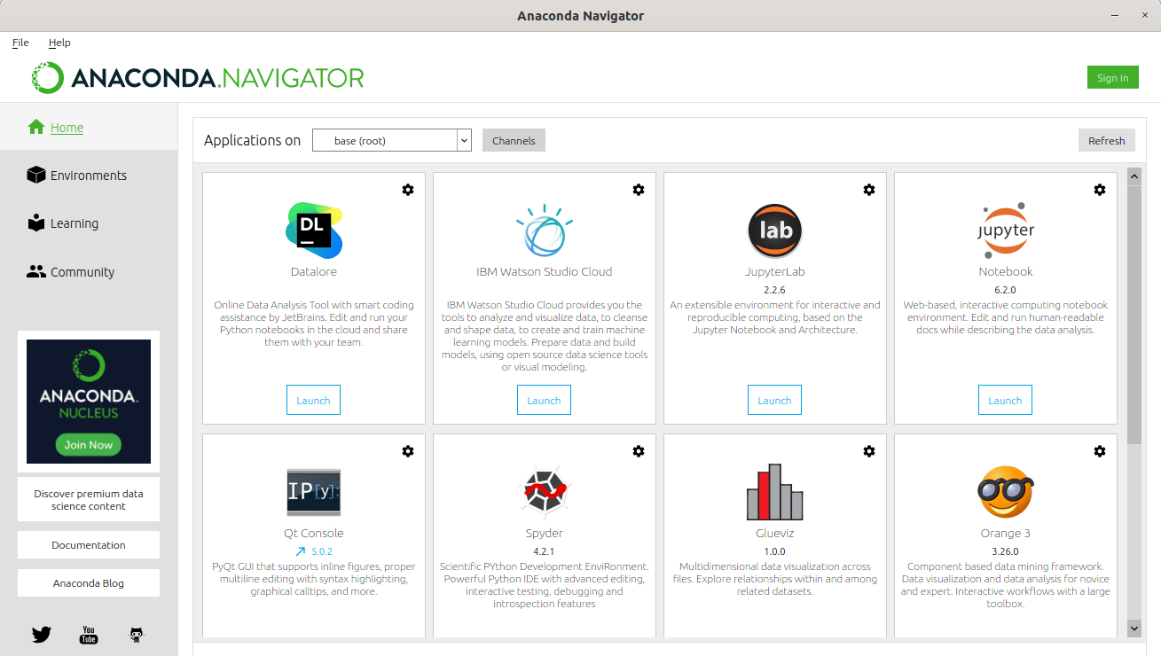
Anaconda
Desktop application that simplifies Python/R package management/environments.
Uses conda, with a repository of 8000+ packages.
Simple download-and-install package that includes several pre-installed applications, including Jupyter Notebook, Rstudio, Spyder and others.
https://www.anaconda.com
Notes:
Comment on ease of installation compared to yum, apt, brew, port, etc

Slide 24

Google Colab
Requires a Google account.
Free (limited) cloud service for running
Jupyter Notebooks in private VMs.
VMs can include GPUs (e.g. to accelerate
ML applications using TensorFlow).
Paid plans provide more resources:
Faster GPU’s
More memory
Longer runtimes
Frequently Asked Questions: https://research.google.com/colaboratory/faq.html
https://colab.research.google.com
Notes:
Magic
%pip install scipy
system
!pip
https://pypi.org/project/pip/

Slide 25
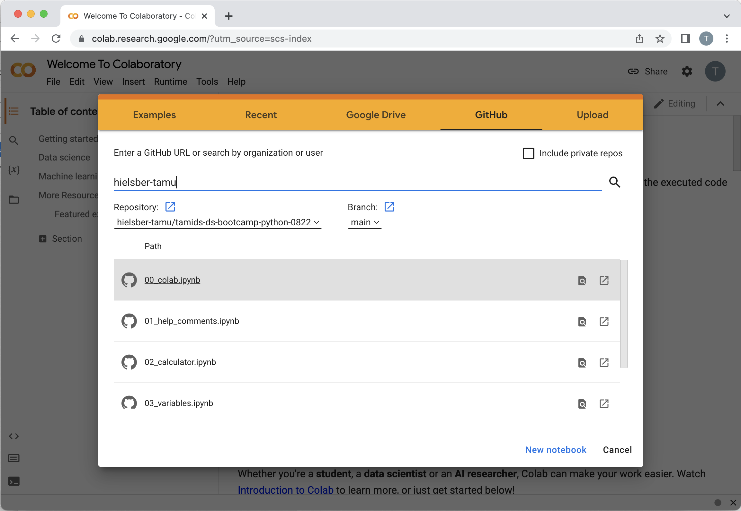
Google Colab
Open colab.research.google.com
If the popup (see image) does not appear then select File > Open Notebook.
Select GitHub from the top bar.
Enter hielsber-tamu and press enter or click the magnifying glass on the right.
Select the tamids-bs-bootcamp-python-0822 repository (main branch).
From the list that follows select the notebook you wish to view.
Make sure you SAVE your changes in your Google Drive
https://colab.research.google.com
Open in Colab

Slide 26
Workshop Materials
Github:
hielsber-tamu/tamids-ds-bootcamp-python-0822
Contains all materials you will see today
TAMIDS Python Primer:
https://training.tamids.tamu.edu/python-primer/
Covers everything in this workshop and more
Consists of 45 videos + Jupyter Notebooks
Videos range from 1 min to 17 min in length
Notes:
notebooks are meant to be self contained
Try to make no assumption about background, prev prog lang exp

Slide 27
Python (Colab)

Slide 28
“Quote, statistic call out, or closing slide to go here”

Slide 29
Break Return @

Slide 30
Lunch Return @

Slide 31
Workshop Materials
Github:
hielsber-tamu/tamids-ds-bootcamp-python-0822
Contains all materials you will see today
TAMIDS Python Primer:
https://training.tamids.tamu.edu/python-primer/
Covers everything in this workshop and more
Consists of 45 videos + Jupyter Notebooks
Videos range from 1 min to 17 min in length
Notes:
notebooks are meant to be self contained
Try to make no assumption about background, prev prog lang exp

Slide 32
Thank you!

